Slide 1
Case Study 2
Employee Attrition
and Salary Prediction

Slide 2
Github
https://github.com/jules-stacy/CaseStudy2DDS.git

Slide 3
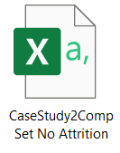
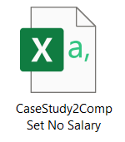
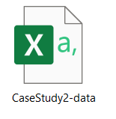
Problem Statement
Are we able to predict whether an employee will leave the company or not?
Are we able to predict a given employee’s salary?

Slide 4
Attrition
Predicting Attrition Rates Using Machine Learning Methods:
K-Nearest-Neighbor

Slide 5
Problems and Solutions
Overrepresentation of “No” cases
Random sub-selection of data with equal numbers of yes and no cases
Overinfluence of numerical variables
Normalization of data on a scale from 0 to 1

Slide 6
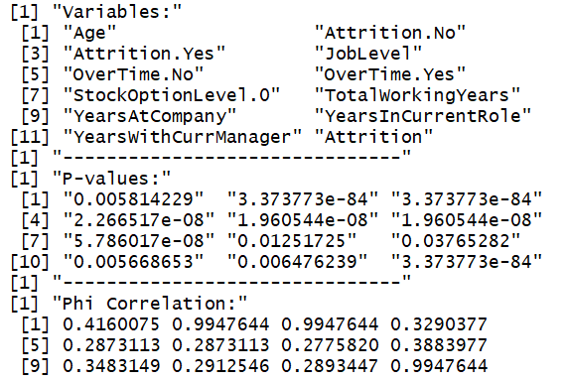
Filter Variables
35 Independent Variables
Chi-Square Test
Filter 1: P-value < alpha=0.05
Filter 2: Phi correlation > 0.25 (Top 8)
Most Influential:
Age, JobLevel,
TotalWorkingYears,
YearsAtCompany

Slide 7
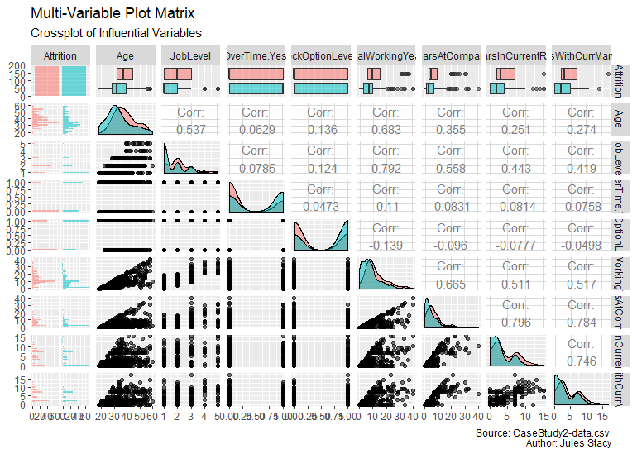

Slide 8
K-NN Testing
Nearest-neighbor
Determines attrition rate based on the types of the nearest known points
Train-Test: separates a training set and uses it as a litmus test on a test set
Leave-One-Out: uses the entire set in one chunk, going point-by-point

Slide 9
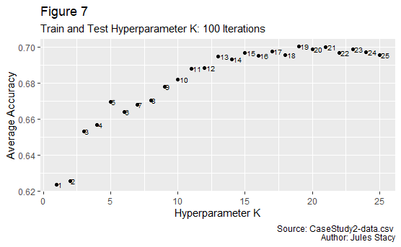
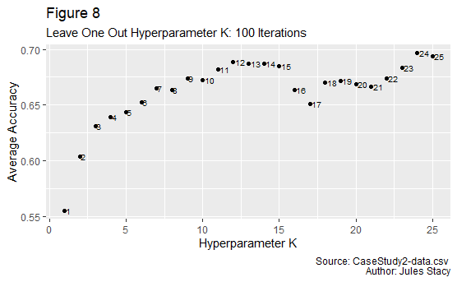
Hyperparameter K
Determine the best number of neighbors
Train-and-Test: k=13
Leave-One-Out: k=13

Slide 10
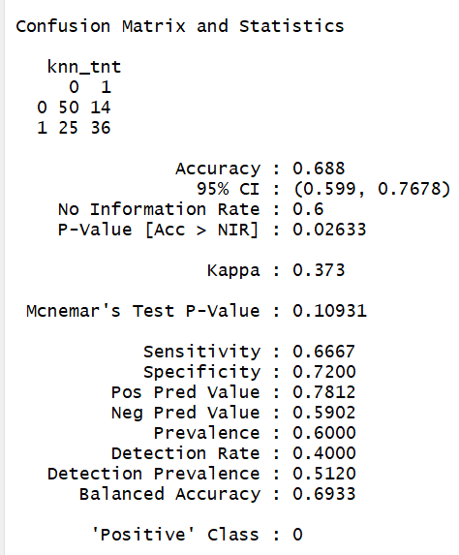
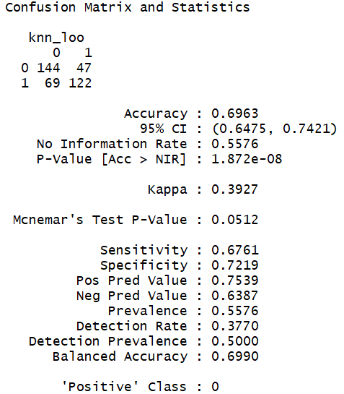
Preliminary Model Training
Computer prediction with 68-70% accuracy

Slide 11
Salary
Regression Modeling to Predict Salaries

Slide 12
Filter Variables
35 Independent Variables
Repeated Linear Model Analysis (ANOVA)
Filter 1: P-value < alpha=0.05
Filter 2: Adjusted R-Squared > 0.1 (Top 11)

Slide 13
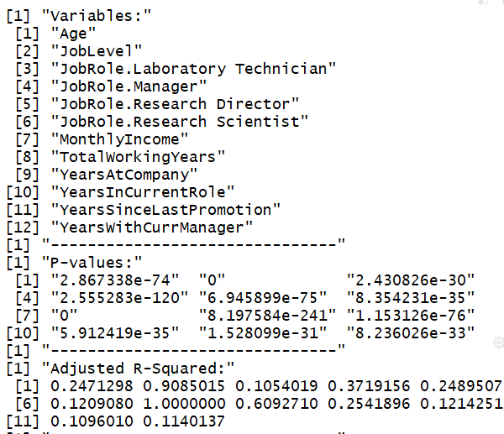
Influential Variables
Most Influential:
JobLevel,
TotalWorkingYears

Slide 14
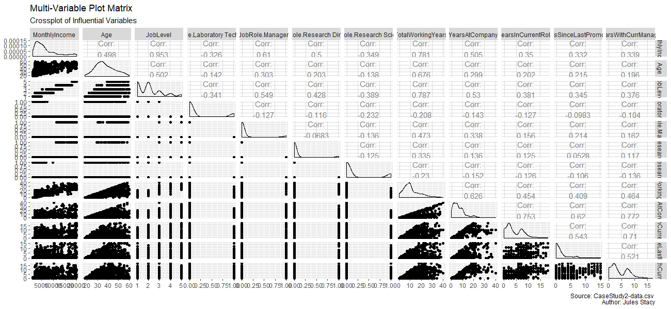

Slide 15
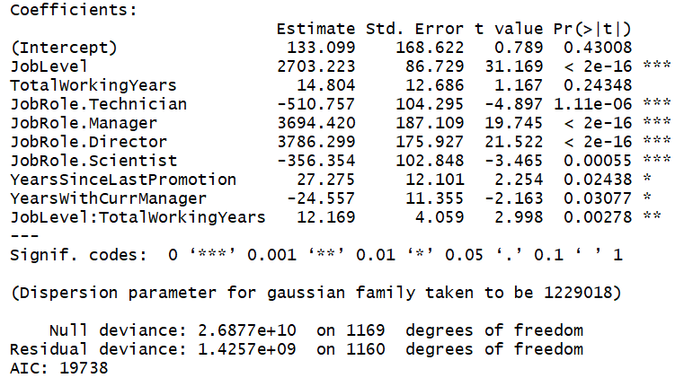
Stepwise Variable Selection
Selected Coefficients Listed Below
One insignificant variable

Slide 16
Conclusions and Insights
Most influential variables in both instances are JobLevel and TotalWorkingYears
JobSatisfaction, NumCompaniesWorked are not predictors of either Attrition or Salary
PercentSalaryHike is not a predictor of Salary – suggests that salary at time of hire is more important
RelationshipSatisfaction and MartialStatus are not predictors, indicating that individuals will not leave a job due to home life
EducationField was not a statistically significant predictor (eg Medical vs. Marketing), but this is likely due to significant overlap of monthly income ranges

Slide 17
Questions or Comments
jstacy@smu.edu

